Slide 1

Apache HBase
March 23, 2020

Slide 2
Apache HBase
HBase Overview
Practical Information
Theory
Lab and next time
Notes:
Bullet Points

Slide 3
What is HBase?
HBase is a column(-family) oriented, non-relational distributed datastore that runs on top of HDFS.
Distributed datastore that runs on top of HDFS: Data and processing occurs across multiple machines
Non-relational: does not use the classic relational database model, where:
There is a pre-defined structure for each table
Queries are written using SQL
Column-family oriented: data is stored together by column family, sorted by rowkey
Notes:
Bullet Points

Slide 4
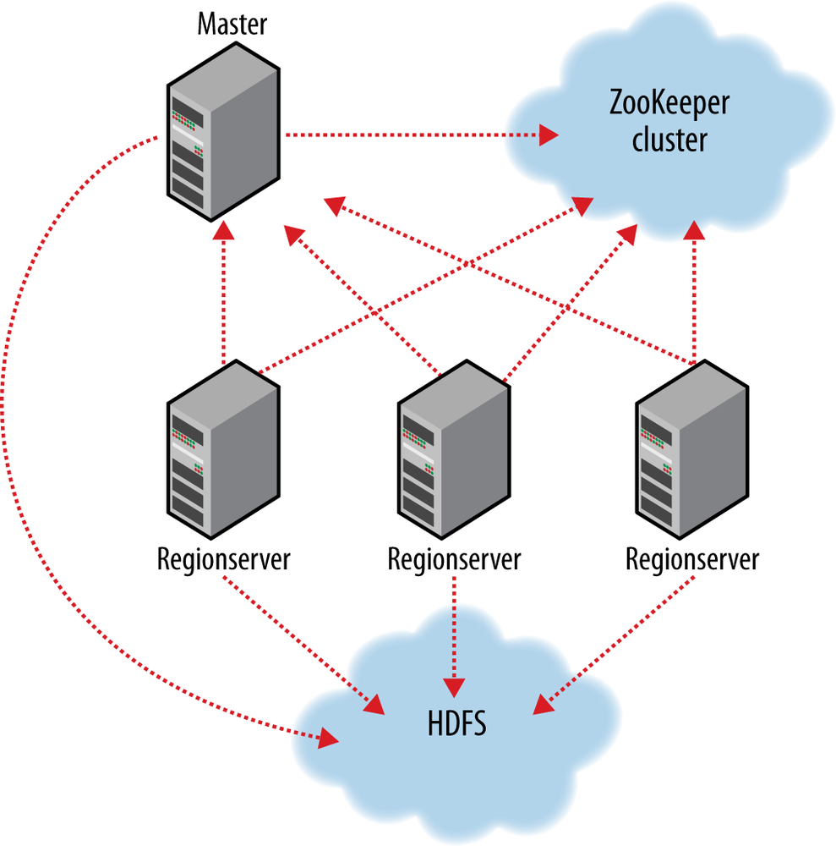
What does an HBase cluster look like?
Notes:
Bullet Points

Slide 5
ZooKeeper, Masters and Region Servers
Master:
Determines region assignment
Handles DDL operations (create, delete tables)
Regionserver:
Responsible for hosting regions (horizontal slices of the data)
Responsible for servicing client requests for its regions
ZooKeeper
Maintains cluster state (which servers are alive and functioning)
Notes:
Bullet Points

Slide 6
HBase terms
Table: A collection of data, made up of rows (identified by rowkeys) and columns (which are grouped into column families). Tables are always stored sorted by rowkey.
Region: A horizontal slice of a table stored on a Regionserver
Rowkey: A byte array which uniquely identifies a row in an HBase table
Column (or column qualifier or column name): A named label that describes a data element
Column family: A set of columns that are physically stored together on disk
Namespace: A logical group of tables (helps you organize your tables like a database)
Notes:
Bullet Points

Slide 7
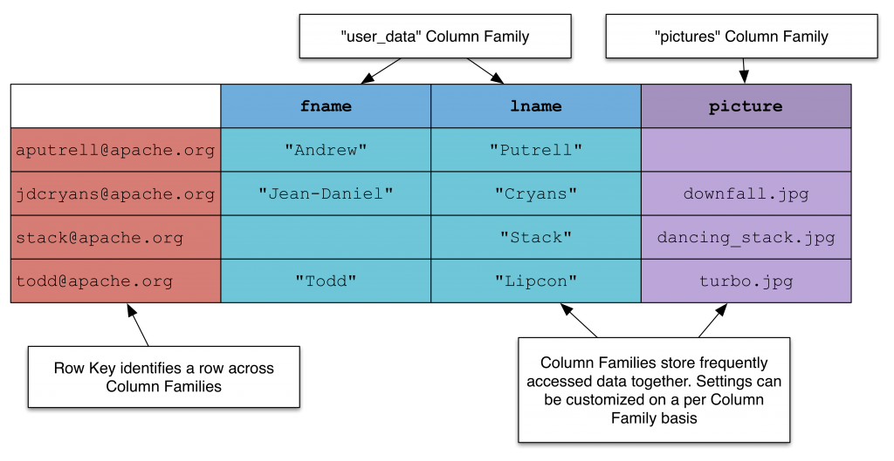
HBase Data Visualization (not really)
Source: https://thenewstack.io/a-look-at-hbase/
Notes:
Bullet Points

Slide 8
HBase Data Visualization
Rowkey | CF | CQ | Timestamp | Column Value
aputrell@apache.org | user_data | fname | 1584995297 | Andrew
aputrell@apache.org | user_data | lname | 1584992562 | Putrell
jdcryans@apache.org | user_data | fname | 1584999913 | Jean-Daniel
jdcryans@apache.org | user_data | lname | 1584994349 | Cryans
stack@apache.org | user_data | lname | 1584995923 | Stack
todd@apache.org | user_data | fname | 1584998187 | Todd
todd@apache.org | user_data | lname | 1584995143 | Lipcon
File 1
Rowkey | CF | CQ | Timestamp | Column Value
jdcryans@apache.org | pictures | picture | 1584992887 | downfall.jpg
stack@apache.org | pictures | picture | 1584999145 | dancing_stack.jpg
todd@apache.org | pictures | picture | 1584990320 | turbo.jpg
File 2
Notes:
Bullet Points

Slide 9
Apache HBase
HBase Overview
Practical Information
Theory
Lab and next time
Notes:
Bullet Points

Slide 10
HBase Operations
Put: Writes a value to HBase for the specified:
table
rowkey
column family
column name
Get: Returns columns (if specified) for the given rowkey. If no column list specified, returns entire row.
Scan: Returns all rows between the start and end rowkeys.
Delete: Removes columns (if specified) from the given rowkey. If no column list specified, removes entire row.
Notes:
Bullet Points

Slide 11
HBase Shell
HBase has a shell built on JRuby:
create 'users', 'user_data', 'pictures'
put 'users', 'aputrell@apache.org', 'user_data:fname', 'Andrew'
put 'users', 'aputrell@apache.org', 'user_data:lname', 'Putrell'
put 'users', 'todd@apache.org', 'pictures:picture', 'turbo.jpg'
get 'users', 'aputrell@apache.org', 'user_data:fname'
get 'users', 'aputrell@apache.org'
delete 'users', 'aputrell@apache.org', 'user_data:fname'
delete 'users', 'todd@apache.org'
Notes:
Bullet Points

Slide 12
HBase Java API
Build a connection to ZooKeeper
val conf = HBaseConfiguration.create();
conf.set("hbase.zookeeper.quorum", "zk01.mydomain.com")
conf.set("hbase.zookeeper.client.port", "2181")
val hbaseConnection = ConnectionFactory.createConnection(conf)
Get table from connection
val table = hbaseConnection.getTable(TableName.valueOf(Bytes.toBytes("users")))
Build a "Get" object for your rowkey
val get = new Get(Bytes.toBytes("aputrell@apache.org"))
Execute the "get" on your table
val result = table.get(get)
Notes:
Bullet Points

Slide 13
HBase Python API
Using the HappyBase library:
pip install happybase
Build a connection to ZooKeeper
import happybase
connection = happybase.Connection('zk01.mydomain.com')
Get table from connection
table = connection.table('users')
Execute a "get" on your table
row = table.row('aputrell@apache.org')
Notes:
Bullet Points

Slide 14
Apache HBase
HBase Overview
Practical Information
Theory
Lab and next time
Notes:
Bullet Points

Slide 15
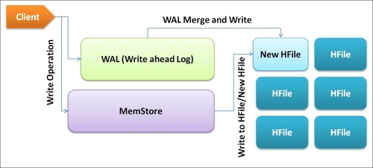
HBase Write Path
Lifecycle of an HBase write:
Put is invoked from an HBase client
Put is routed to the appropriate Region/RegionServer based on its rowkey
Put is entered into the "WAL" (write-ahead log) for durability
Put is entered into the memstore
After the memstore fills up, it is flushed to disk as an HFile
Source: https://subscription.packtpub.com/book/big_data_and_business_intelligence/9781783985944/2/ch02lvl1sec19/reading-and-writing-cycle
Notes:
Bullet Points

Slide 16
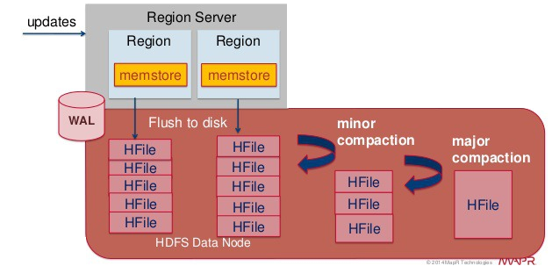
Compaction
6. As more HFiles accumulate, once their number exceeds a defined threshold, a compaction runs to combine multiple small HFiles into smaller ones
Minor compaction:
  merge HFiles into several larger files
Major compaction:
  all HFiles get compacted into 1 large HFile
  deleted records are physically purged
Source: https://www.slideshare.net/caroljmcdonald/h-base-nosqlcarol
Notes:
Bullet Points

Slide 17
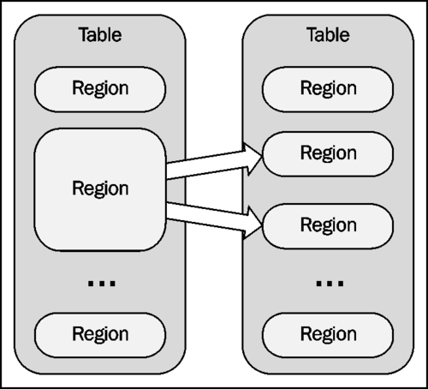
Region Splitting
7. When the amount of data in a region exceeds a defined threshold, the region is split into 2 smaller regions.
Notes:
Bullet Points

Slide 18
HBase Write Path Review
Put is invoked from an HBase client
Put is routed to the appropriate Region/RegionServer based on its rowkey
Put is entered into the "WAL" (write-ahead log) for durability
Put is entered into the memstore
After the memstore fills up, it is flushed to disk as an HFile
As more HFiles accumulate, once their number exceeds a defined threshold, a compaction runs to combine multiple small HFiles into 1 larger one
When the amount of data in a region exceeds a defined threshold, the region is split into 2 smaller regions.
Assuming no purge process, repeat steps 6-8 ad infinitum
Notes:
Bullet Points

Slide 19
HBase Read Path
Check the memstore
Check the most recently created HFile
Check the next most recently created HFile
…
This can be extremely fast:
Checking the memstore is an in-memory operation
If you compactions are running regularly, you shouldn't have too many HFiles
You can optionally include metadata (bloom filters) as a header in your HFiles that can determine whether a rowkey exists in a certain file without having to scan the whole file
  Enables you to quickly skip files which don't contain a rowkey
Notes:
Bullet Points

Slide 20
Choosing a row key
What would happen if epoch timestamp (eg, the number of seconds since 1/1/1970) were chosen as your row key?
Today = 1584995297
1 year later = 1616531297
All the data for the entire year is going to be sent to one region, overloading that node and leaving the rest of your cluster unutilized - hotspotting.
Notes:
Bullet Points

Slide 21
Choosing a row key
Rowkey | Transaction1 | Transaction2 | Transaction3 | TransactionN
TIM | {"Date":"2020-02-11 13:56:00", "Amt":"$37.00", "Category": "37"} | {"Date":"2020-01-19 01:54:00", "Amt":"$99.00", "Category": "56"} | {"Date":"2020-06-16 11:38:00", "Amt":"$150.00", "Category": "82"} | {"Date":"2020-07-29 07:59:00", "Amt":"$77.00", "Category": "77"}
WILL | {"Date":"2020-05-08 22:00:00", "Amt":"$124.00", "Category": "99"} | {"Date":"2020-04-28 10:32:00", "Amt":"$42.00", "Category": "30"} | {"Date":"2020-03-19 18:12:00", "Amt":"$48.00", "Category": "23"} | {"Date":"2020-05-22 10:01:00", "Amt":"$25.00", "Category": "40"}
KIT | {"Date":"2020-03-05 08:05:00", "Amt":"$88.00", "Category": "43"} | {"Date":"2020-02-29 17:55:00", "Amt":"$139.00", "Category": "5"} | {"Date":"2020-02-01 23:40:00", "Amt":"$84.00", "Category": "51"} | {"Date":"2020-07-15 15:20:00", "Amt":"$56.00", "Category": "68"}
To find the transaction "TIM" made at 2020-06-16 11:38:00:
Pull "TIM"s row down from HBase to the client side
Iterate the list of results which is returned to find the correct transaction
Can this be improved?
Notes:
Bullet Points

Slide 22
Choosing a row key
Rowkey | Transaction1
TIM_2020-02-11T13:56:00 | {"Date":"2020-02-11 13:56:00", "Amt":"$37.00", "Category": "37"}
TIM_2020-01-19T01:54:00 | {"Date":"2020-01-19 01:54:00", "Amt":"$99.00", "Category": "56"}
TIM_2020-06-16T11:38:00 | {"Date":"2020-06-16 11:38:00", "Amt":"$150.00", "Category": "82"}
TIM_2020-07-29T07:59:00 | {"Date":"2020-07-29 07:59:00", "Amt":"$77.00", "Category": "77"}
... | ...
To find the transaction "TIM" made at 2020-06-16 11:38:00
Do a single GET operation: get 'transactions', 'TIM_2020-06-16T11:38:00'
No longer have to copy down all of the data for this user from HBase to the client - can filter based on rowkey at the server.
This is a Good Thing: you want to push as much logic as you can into your rowkey.
Notes:
Bullet Points

Slide 23
HBase Column Naming
Rowkey | Column Qualifier | Column Value
aputrell@apache.org | fname | Andrew
jdcryans@apache.org | fname | Jean-Daniel
What if the "fname" column was changed to "supercalifragilisticexpialidocious"?
Since the column qualifier is stored with each "HFile row", long column names can cause a tremendous increase in the size of your table.
Over half the storage in this table would be devoted to that column name!
Choose the shortest names you can live with to describe your columns!
Notes:
Bullet Points

Slide 24
HBase Column Naming Example
HBase data
Rowkey | Column Qualifier | Column Value
00f6b39c9 | f1:A | 07/14/1980
00f6b39c9 | f1:B | 400 Maple St.
... | ... | ...
00f6b39c9 | f1:AA | (314)-555-4321
Decoder ring
Rowkey | Column Qualifier | Column Value
A | f1:col_name | birth_date
B | f1:col_name | address
... | ... | ...
AA | f1:col_name | phone_number
Notes:
Bullet Points

Slide 25
Apache HBase
HBase Overview
Practical Information
Theory
Lab and next time
Notes:
Bullet Points

Slide 26
HBase Lab
Everyone has a "users" table set up for you on a GCP HBase cluster
Table name is "$EMAIL_PREFIX:users" (remove any periods from your email handle)
Table contains ~2.5 million rows of data
ZK connection information: 35.184.255.239
1 setup step required for this lab: Add the line below to your hosts file:
35.184.255.239 quickstart.cloudera
On Windows: c:\Windows\System32\Drivers\etc\hosts
On Mac/Ubuntu: /etc/hosts
Notes:
Bullet Points

Slide 27
HBase Lab
What is user=10000001 email address? Determine this by using a Get that *only* returns that user's email address, not their complete column list.
Write a new user to your table with:
(Note that favorite_color is a new column qualifier in this table, and we are not specifying some other columns every other record has: DOB, email address, etc.)
How many user IDs exist between 10000001 and 10006001? (Not all user IDs exist, so the answer is *not* 6000)
Delete the user with ID = 99 that we inserted earlier.
There is also an operation that returns multiple results in a single HBase "Get" operation. Write a single HBase call that returns the email addresses for the following 5 users: 9005729, 500600, 30059640, 6005263, 800182 (Hint: Look at the Javadoc for "Table" in Scala and the Happybase "Retrieving rows" section of the documentation)
Rowkey | 99
username | DE-HWE
name | The Panther
sex | F
favorite_color | pink
Notes:
Bullet Points

Slide 28
Hive Homework
Chapter 17 - Hive
Chapter 12 - Avro
Optional: Chapter 13 - Parquet
Optional: Chapter 1 - Meet Hadoop
Reminder on the structure of this program:
Our goal so far has been to spend on class on one technology. Next week will be our 6th week, and our last traditional class. It’ll be on Hive, and along with Hive include background on MapReduce and different serializations.
That means this is the last week of “homework” too.
Starting on Week 7 - We will be doing projects the last two weeks. Piecing together each of these technologies through the last two weeks and creating a demonstrable project. We will still meet on Monday ( probably shortened a bit ), and also hold some office hours throughout the week for people who are working through questions and things like that.
Oh yeah, and T-Shirts came in. Gotta wait until at least May for them!
Any questions?
Notes:
Bullet Points

